Slide 2
Exercise - MSE Loss
Consider the neural network with two inputs x₁ and x₂ and the initial weights are w₀ = 0.5, w₁ = 0.8, w₂ = 0.3. Draw the network, compute the output, mean squared loss function and weight updation when the input is (1, 0), the learning rate is 0.01 and target output is 1. Assume any other relevant information.
1
w₀
w₁
Σ
x₁
σ
yˆ
w₂ x₂

Slide 3
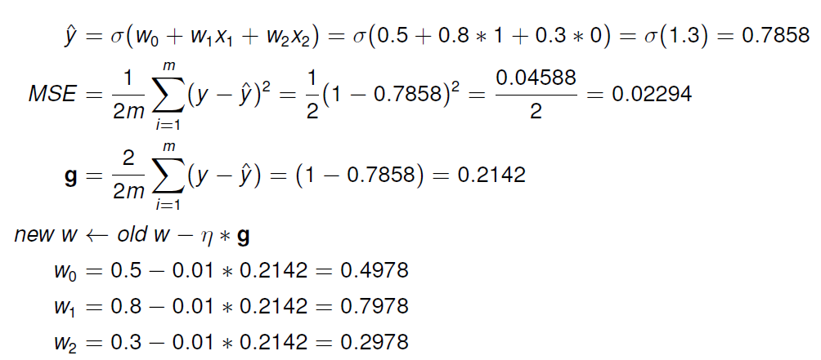
Solution

Slide 4
Exercise - BCE
Consider the neural network with two inputs x₁ and x₂ and the initial weights are w₀ = 0.5, w₁ = 0.8, w₂ = 0.3. Draw the network, compute the output, binary cross entropy loss function and weight updation when the input is (1, 0), the learning rate is 0.01 and target output is 1. Assume any other relevant information.
1
w₀
w₁
Σ
x₁
σ
yˆ
w₂ x₂

Slide 5
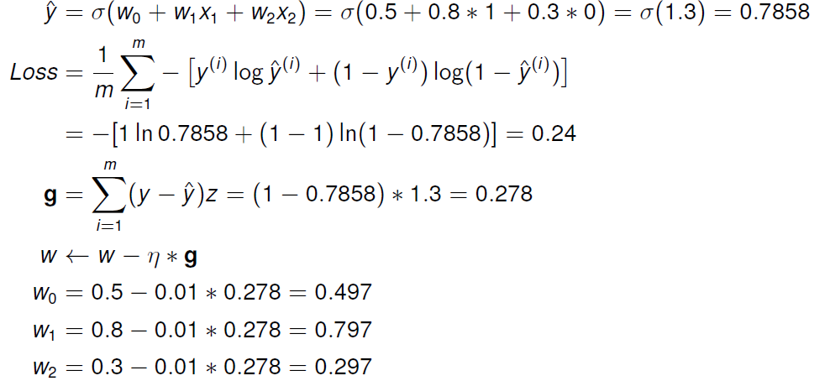
Solution

Slide 6





















Exercise (without vectorization)
W₁₁^{[1]} =0.2
W₁₂^{[1]} =0.4
W₁₃^{[1]} = -0.5
W₂₁^{[1]} = -0.3
W₂₂^{[1]} =0.1
W₂₃^{[1]} =0.2
W₁₁^{[2]} =-0.3
W₁₂^{[2]} = -0.2
b₁^{[1]} = -0.4
b₂^{[1]} = -0.2
b₁^{[2]} = 0.1
$$w_{11}^{[1]}$$
$$z_{1}^{[1]}$$
$$a_{1}^{[1]}$$
$$w_{11}^{[2]}$$
$$x_{1}$$
$$w_{12}^{[1]}$$
$$w_{13}^{[1]}$$
$$b_{1}^{[1]}$$
$$z_{1}^{[2]}$$
$$a_{1}^{[2]}$$
$$\hat{y}$$
$$x_{2}$$
$$w_{21}^{[1]}$$
$$w_{12}^{[2]}$$
$$b_{1}^{[2]}$$
$$w_{22}^{[1]}$$
$$z_{2}^{[1]}$$
$$a_{2}^{[1]}$$
$$x_{3}$$
$$w_{23}^{[1]}$$
$$b_{2}^{[1]}$$
α=0.9
For X= { 1, 0, 1} and y=1
Find the cross entropy loss and weight updates after 1st iteration

Slide 7
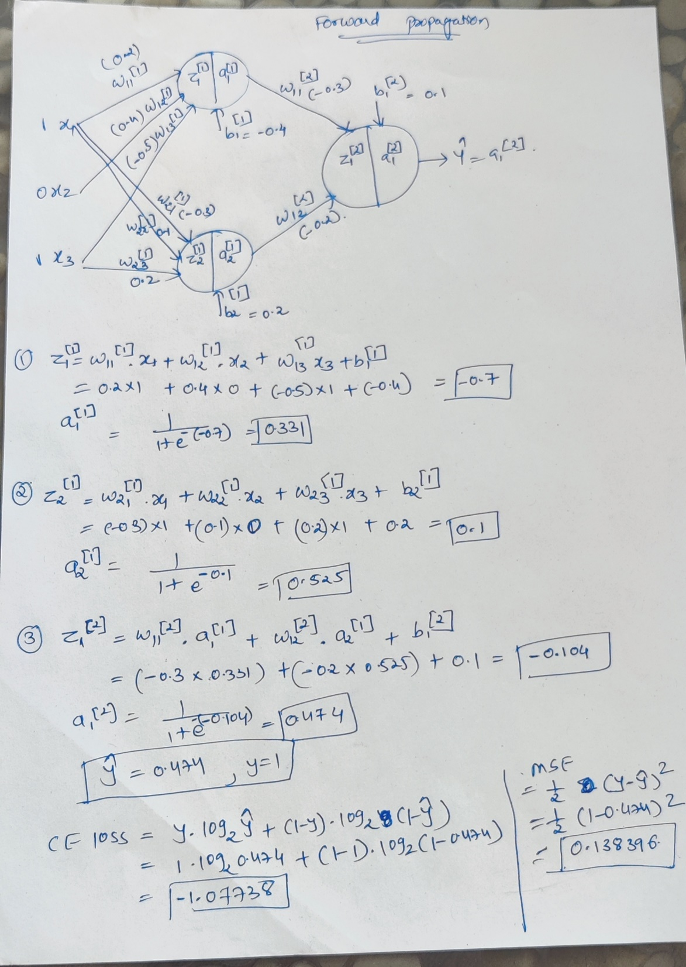

Slide 8
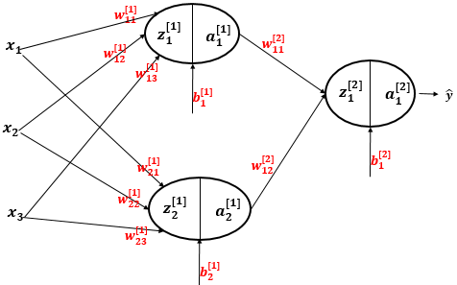
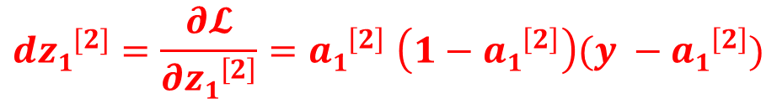
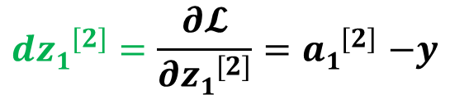
Continued……
For the layer 2
$$d{z1}^{[2]}=\frac{∂𝓛}{∂{z1}^{[2]}}{=a1}^{[2]}−y$$
← For Cross entropy cost function
$$d{z1}^{[2]}=\frac{∂𝓛}{∂{z1}^{\left[2\right]}}{=a1}^{\left[2\right]}\left(1−{a1}^{\left[2\right]}\right)(y −{a1}^{\left[2\right]})$$
← For MSE cost function

Slide 9
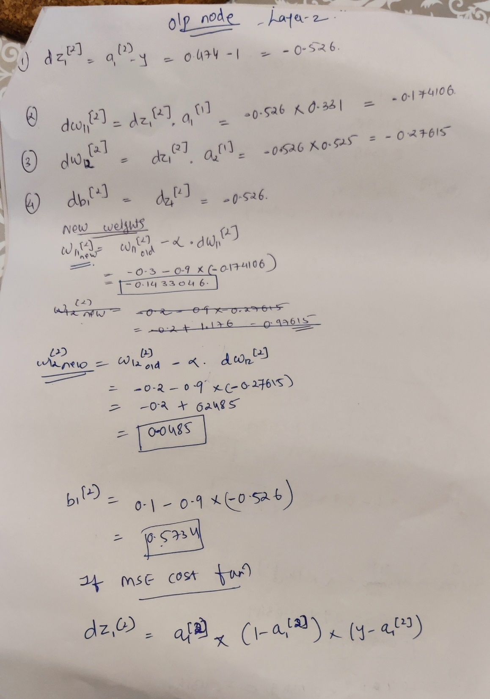

Slide 10
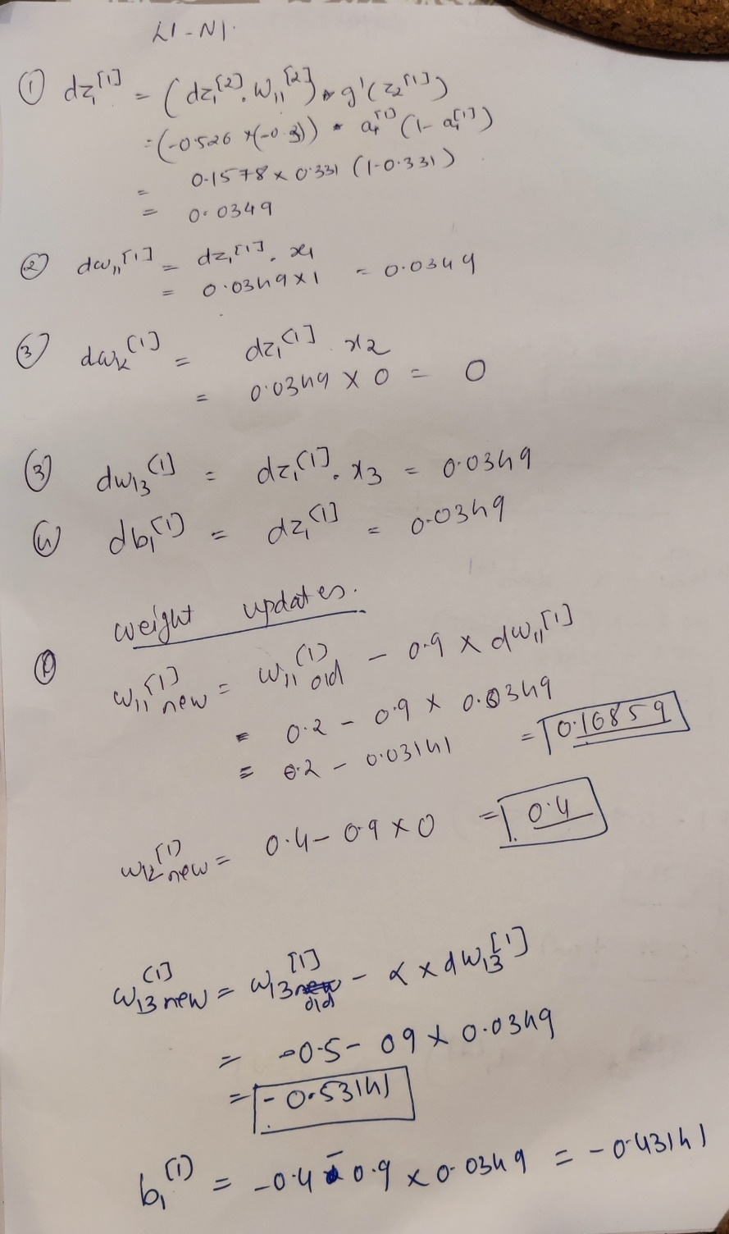

Slide 11
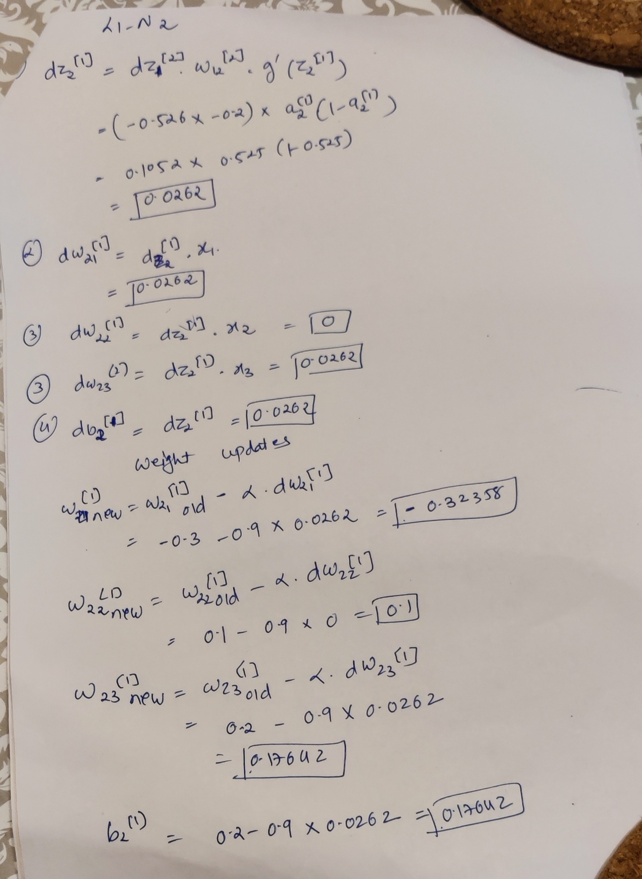

Slide 12










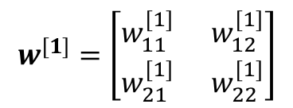
Exercise – With vectorization
$$w^{[1]}=\left[\begin{matrix}w_{11}^{[1]} & { w}_{12}^{[1]} \\ w_{21}^{[1]} & { w}_{22}^{[1]}\end{matrix}\right]$$
3
1
x
W^{[1]}
4 3
0
5 6
prod = W ^{[1]T}x
_{b}[1]
−1
1
-1
-2
1
−2
7
y = 1
z^{[1]} = prod + b^{[1]}
x₁
_{a}[0]
4
_{a}[1]
-3
_{a}[2]
yˆ
_{W} [2]
1
5
1
1
_{a}[1] _{= σ(z}[1]₎
−3 −2
3
-2
₇
yˆ
_{a}[0]
6
_{a}[1]
_{prod = W} [2]T_{a}[1]
_{b}[2]
x₂
2
2
z^{[2]} = prod + b^{[2]}
_{a}[2] _{= σ(z}[2]₎

Slide 13
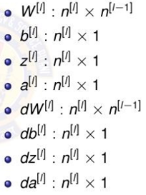





Computation Graph for Forward Pass
3
1 4 3
x
_{W} [1]
0 5 6
4
prod = W ^{[1]T}x
_{b}[1]
−1
3
−2
3
z^{[1]} = prod + b^{[1]}
1
0.95
_{a}[1] _{= σ(z}[1]₎
_{W} [2]
−3 −2
0.73
−4.31
_{b}[2]
₇
yˆ
_{prod = W} [2]T_{a}[1]
2.69
z^{[2]} = prod + b^{[2]}
0.94
₁
_{a}[2] _{= σ(z}[2]₎

Slide 14
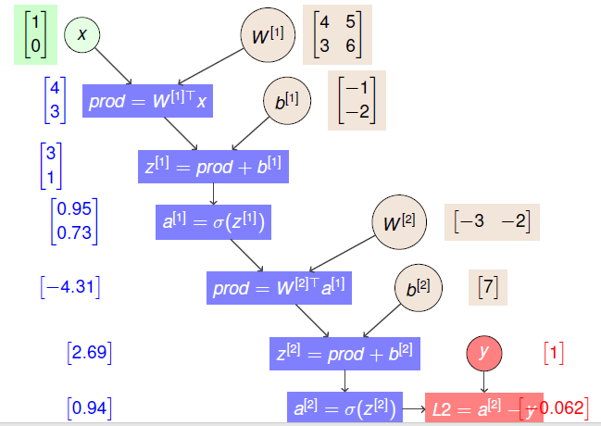
Computation Graph for Cost Function

Slide 15
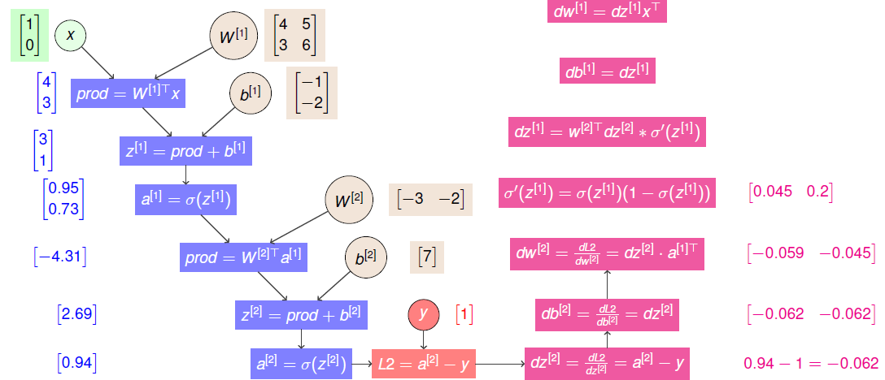
Computation Graph for Backward Pass

